Slide 1


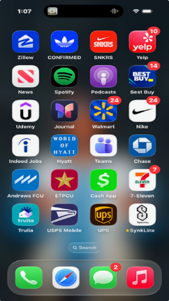
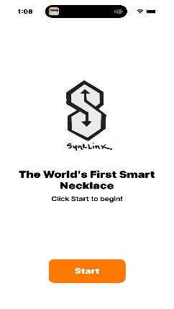
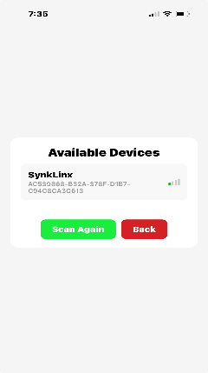
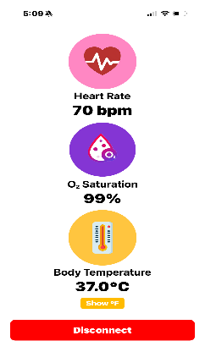
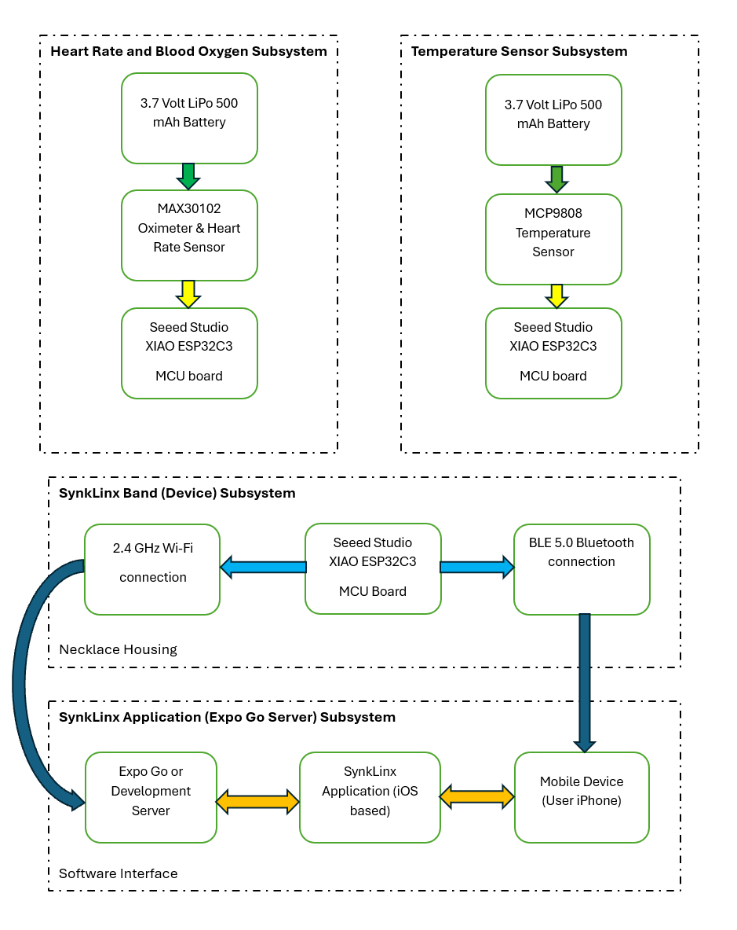
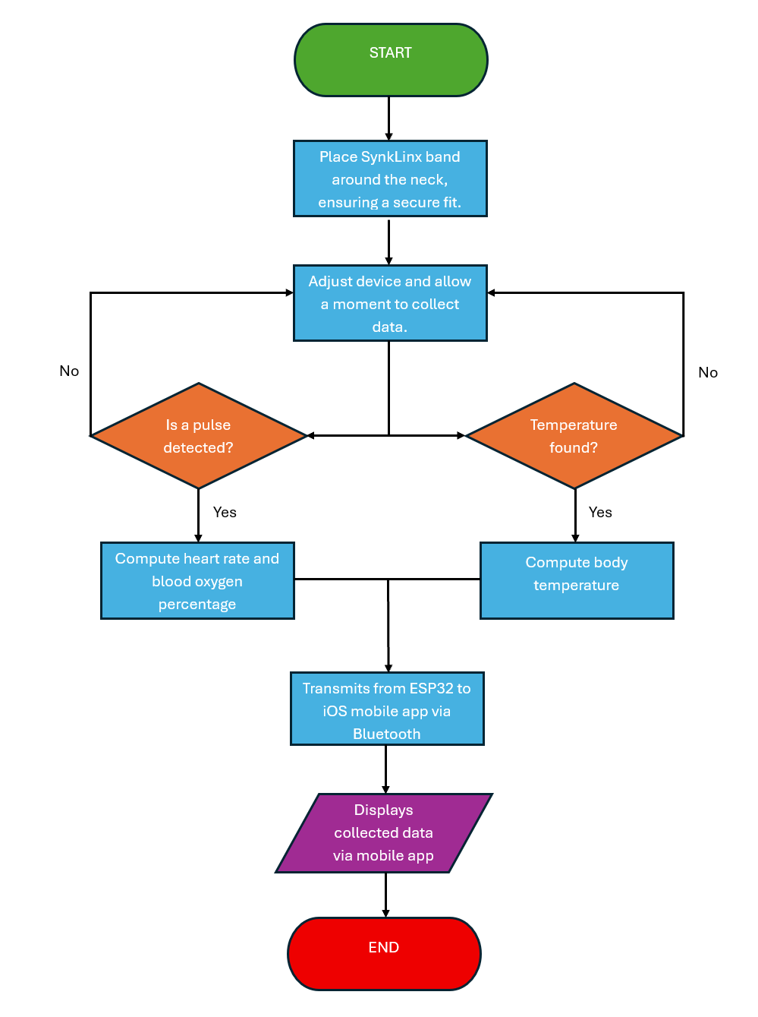
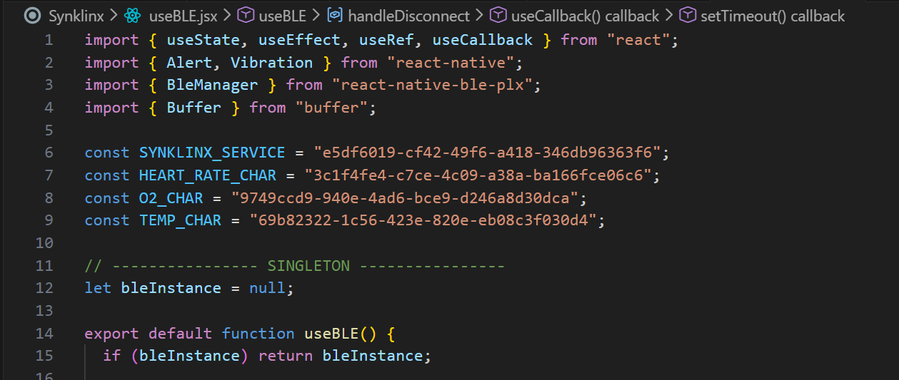
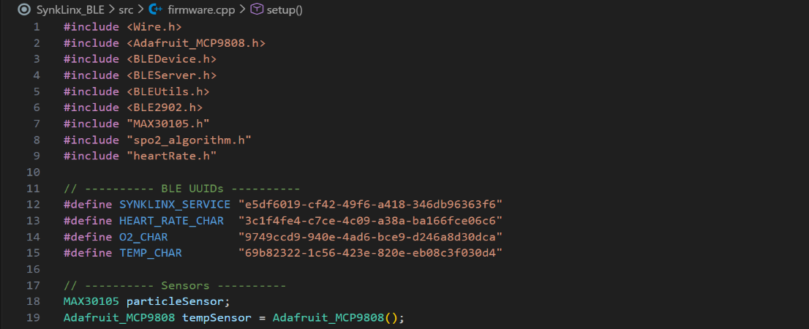
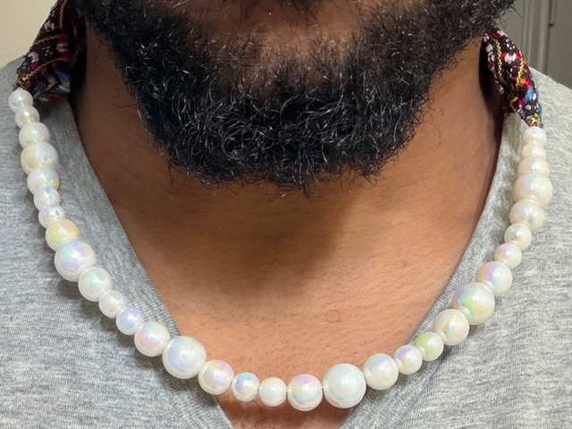
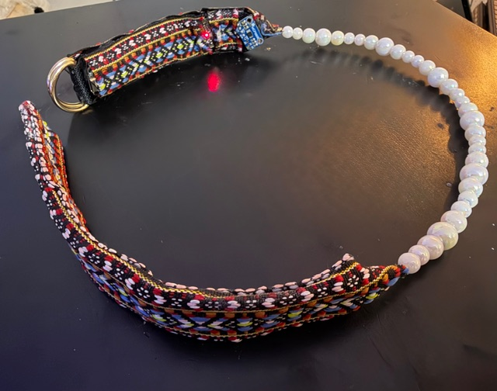
SynkLinx - “The World’s First Smart Necklace”
Computer Engineering
DESIGN EXPO
2025
Jordan Abron
Department of Electrical and Computer Engineering
PROJECT DESCRIPTION
PROTOTYPE
PROTOTYPE (CONTINUED)
The device is intended to be the first “smart necklace” on the consumer market.
  The apparatus is worn around the neck
  Its sensors collect and stream data in real time from the device to an iOS app.
Provides health notifications for three specific vital signs:
  Heart Rate (beats per minute)
  Blood Oxygen Saturation (%)
  Core Temperature (Celsius/Fahrenheit)
Device Flowchart
Figure 1 is the block diagram representing the hardware and software processes
Figure(s) 2 and 3 are the final device prototype
UUIDs for firmware and React Native framework bridge hardware and software together via Bluetooth connectivity.
App Transition Screens
useBLE.jsx file via React Native
Figure 1.System Block Diagram
The secondary purpose of this project is to provide a trendy, alternative option in wearables.
  Made of safe, non-toxic materials
  Lithium-ion rechargeable battery ()
  Breakaway feature for safety precaution
Firmware.cpp via Arduino IDE
Service & Characteristic UUIDs
Figure 2. SynkLinx Prototype (in use)
Figure 3. SynkLinx Prototype
DESIGN REQUIREMENTS
TESTING THE PROTOTYPE
(ACKNOWLEDGEMENTS
Component | Function(s) | Data Retrieval/Sampling | Dimensions(mm) | Weight | Sensor Range/Accuracy
Battery: 3.7 Volt LiPo 500mAh | Powers wearable smart necklace | N/A | 52 x 20 x 5 (L x W x T) | 10g | N/A
XIAO ESP32-C3 | MCU: BLE, Wi-Fi, sensor comm | I2C up to 400 kHz | 21 X 17.5 x 3.5 | ~3g | N/A
MAX30102 Pulse Oximeter / HR Sensor | Heart Rate & SpO₂ | Configurable up to 3200 samples/sec | ~12 x 11 x 3 | ~1g | HR: 30–250 BPM SpO₂: 0–100% Accuracy: HR ±1–2 BPM, SpO₂ ±2–3%
MCP9808 Temperature Sensor | Body/ Ambient Temperature | 0.25 °C resolution, ~250 ms conversion | 4.5 x 4.5 x 1.5 | ~1g | -40 °C to +125 °C Accuracy ±0.5 °C
Wiring/SynkLinx Housing | Interconnect and wearable housing | N/A | 558 x 25 x 10 | g | N/A
Testing and validation was performed at home prior to necklace construction.
I would like to thank the entire faculty and staff at UT Tyler Department of Electrical and Computer Engineering, specifically Dr. Frederic Rizk and Dr. Vijayalakshmi Saravanan for their advice, grace, analysis and support during this semester and in the inception of this project. They both provided critical analysis and insight that weighed heavily on the success of the device.
I also would like to thank my dear wife Kaitlyn and my parents for their financial contributions regarding the materials and project construction
Everyone mentioned above made an impact well beyond what words can convey. Without them, SynkLinx would not have been possible.
 | Experimental | Actual | Percent Error
Heart Rate (bpm) | 57.67 | 61.40 | 6.07%
Core Temperature F(C) | 99.32(37.40) | 97.22(36.23) | 2.16%
Blood Oxygen (%) | 96.20 | 97.22 | 1.05%
Heart rate, oxygen saturation and core temperature were collected using existing devices (pulse oximeter, thermometer), then compared data with smart necklace data.
  Readings for pulse oximeter were collected using a finger apparatus
Design features an ergonomic band that contours around the neck, ensuring a secure fit for data collection
The pulse oximeter sensor is positioned near the carotid artery and uses an infrared sensor to detect a pulse.
The temperature sensor is positioned close to where the neck and clavicle join.
  Body temperature based on homeostasis

